Slide 1


Task 1 Web scraping to gain company insights
Scrape and analyse customer review data to uncover findings for
Powered By https://www.theforage.com/
Author: Majid Mahmood
Dated: 24-05-2023

Slide 2
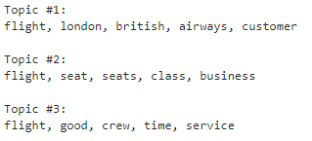

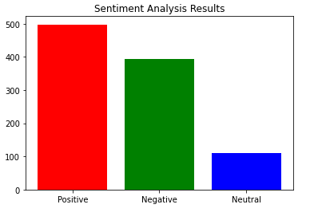
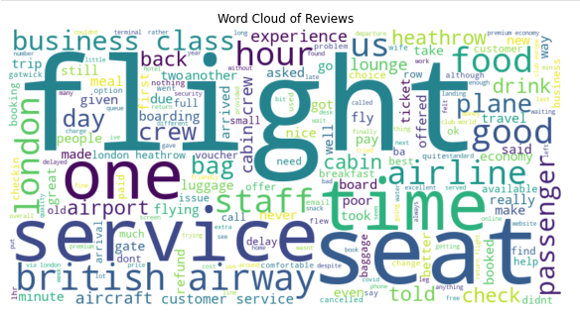
Task 1:Web scraping to gain company insights
Topic Modelling
Data Scraping Done
Data Cleaning Done
Data analysis by
Topic Modelling Done
Sentiment Analysis Done
Word clouds Done
WORDCLOUD

Slide 3
Task 1:Web scraping to gain company insights
Topic Modeling
The top 3 topics in the data are:
flight, london, british, airways, customer
flight, seat, seats, class, business
flight, good, crew, time, service
Sentiment Analysis
The overall sentiment of the data is positive. The score for positive is 498 out of 1000.
Word Clouds
The following words are the most common in the data:
Flight
Seat
Time
Service
Good
Conclusion
The data analysis shows that British Airways has a positive reputation among its customers. The most common topics of praise are the flight experience, customer service, and food and beverage. The overall sentiment of the data is positive.
Here are some recommendations for British Airways based on the data analysis:
Continue to focus on providing a positive flight experience for customers.
Make sure that customer service representatives are friendly and efficient.
Offer high-quality food and beverage options.
Consider offering additional amenities or services to improve the customer experience.

